Slide 1
Satellite Close Approach Analysis
Steven Shi

Slide 2


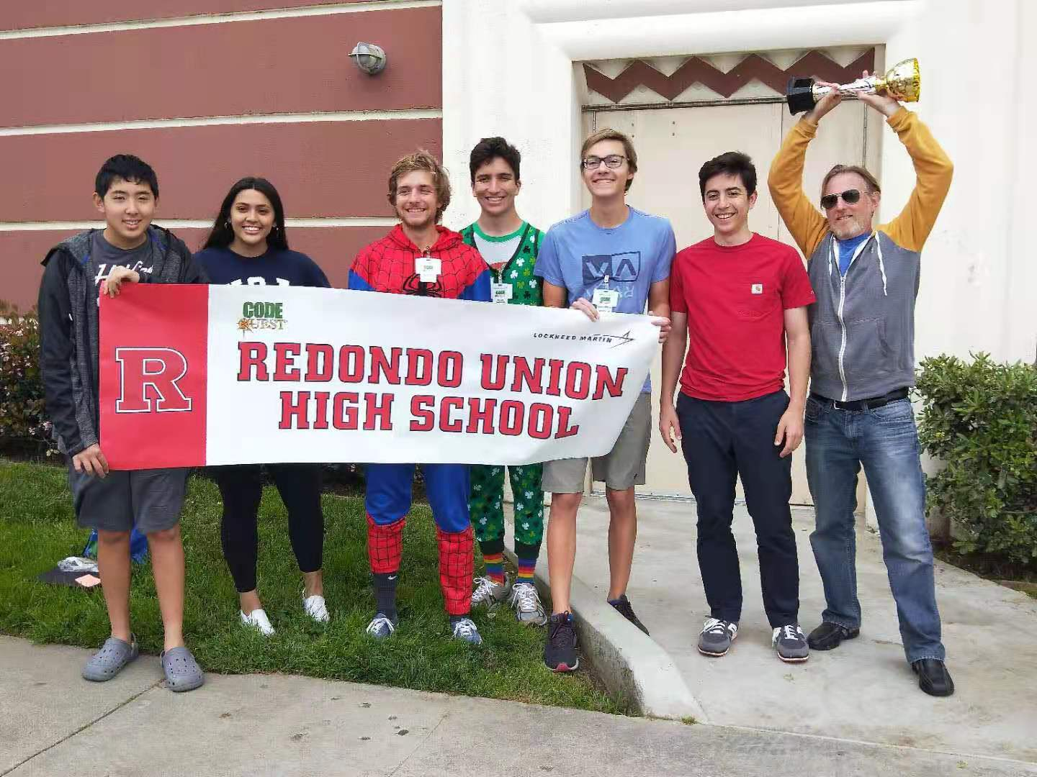
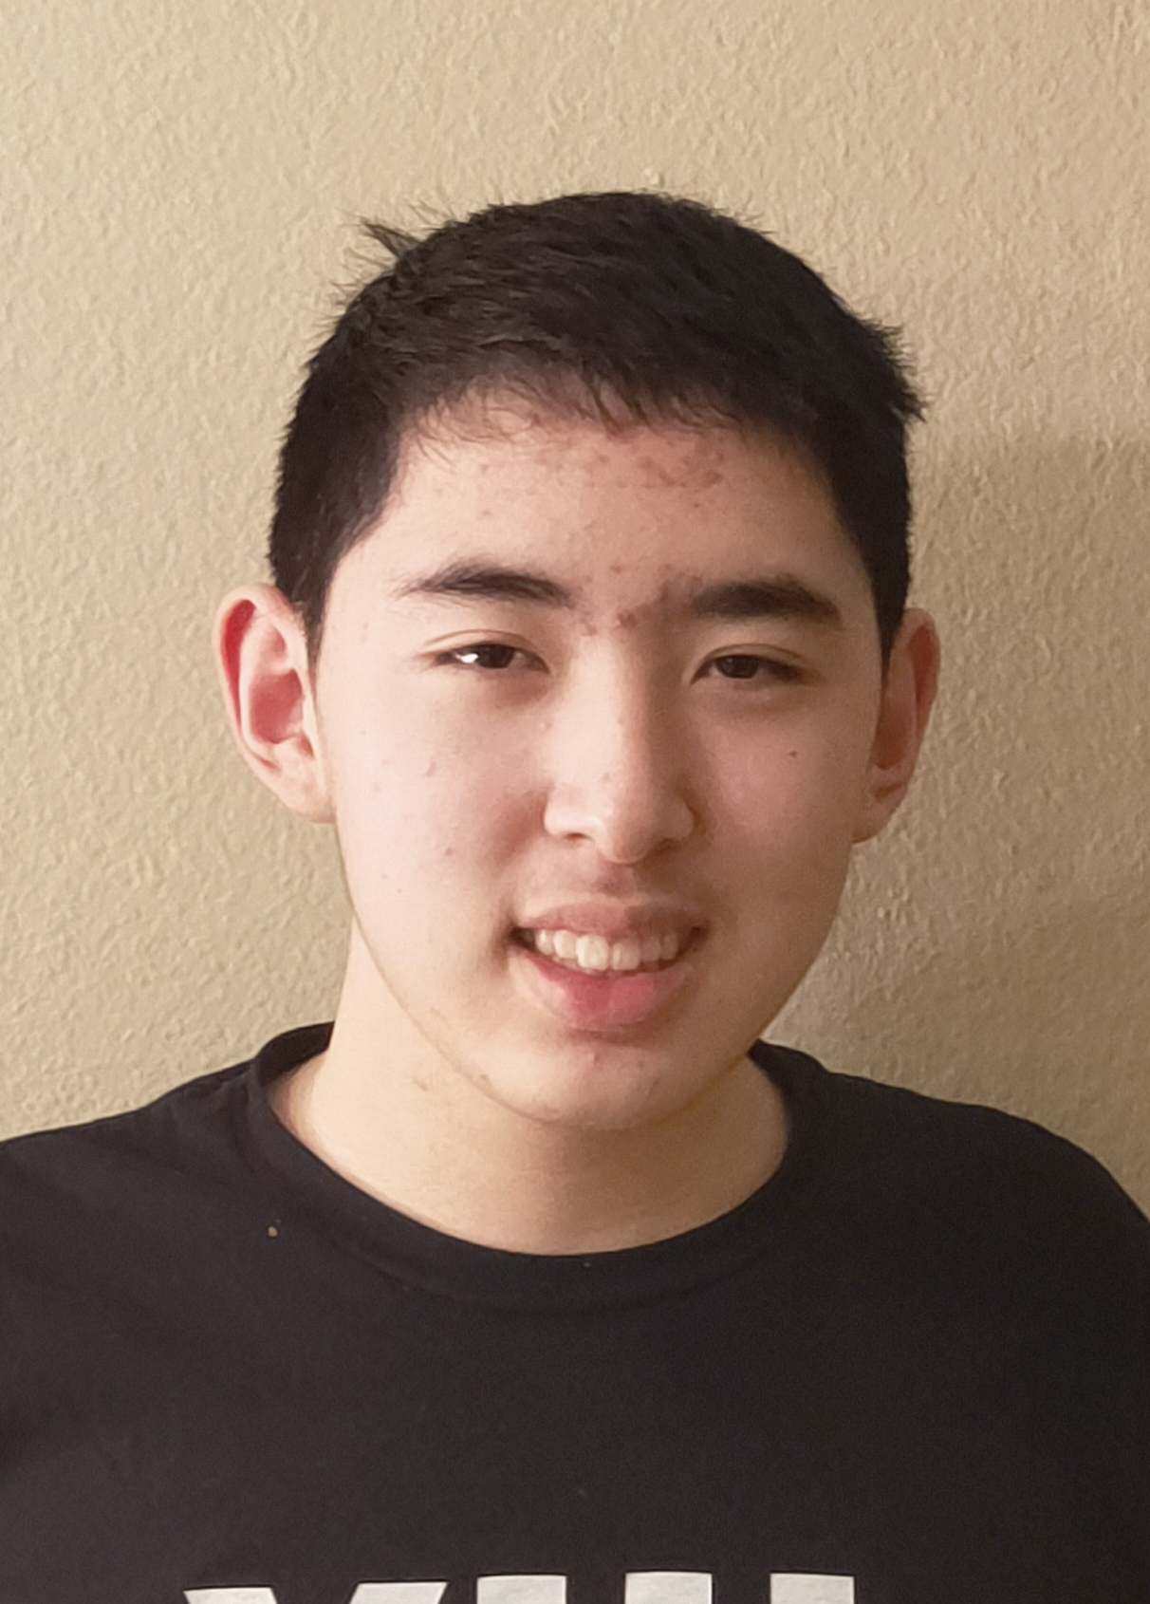

A little About Me
Student at Redondo Union High School
Aspiring Software Engineer
Software Mentors: Megumi Telles and Bryce Ockerman
Project Mentor: Galen Stevens
Hobbies:
Programming
Cybersecurity
Chess
Video Games

Slide 3
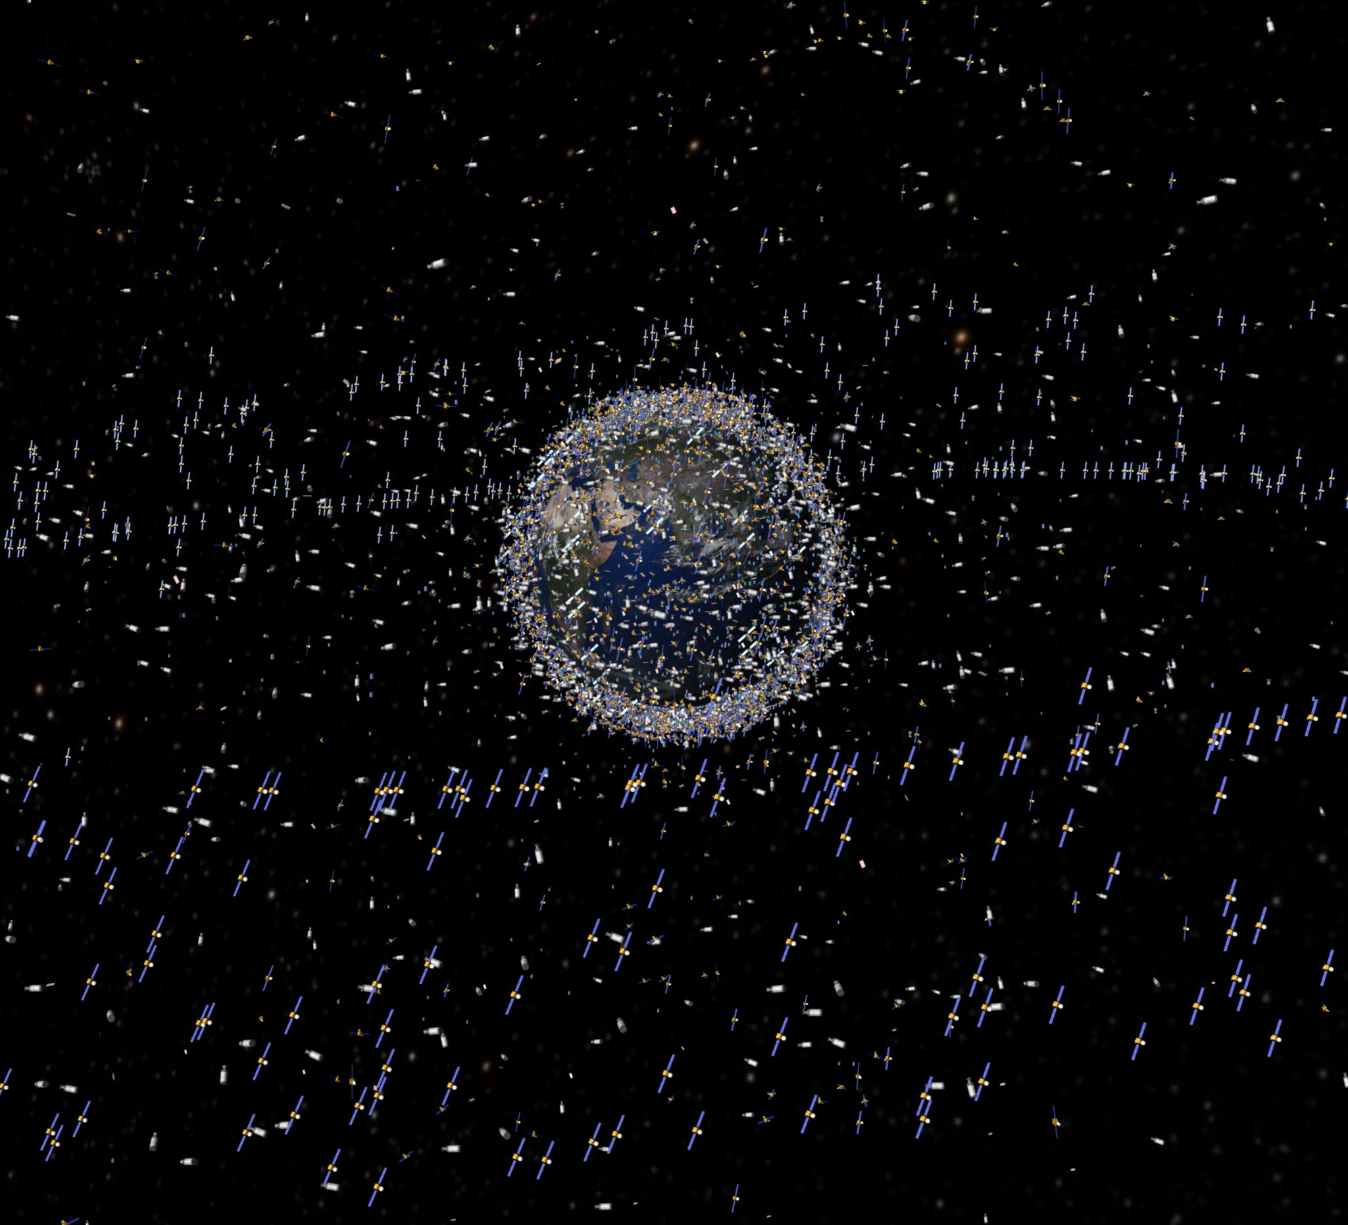
The Problem
There are over 30,000 objects orbiting around earth
Operational satellites provide essential functions, are expensive, and very prone to damage
Collisions are very possible, lots of financial loss, causes more space debris
Notes:
Address vicious cycle of debris -> collisions -> more debris -> more collisions

Slide 4
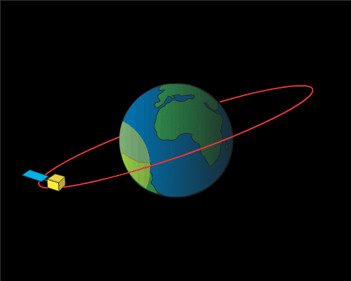
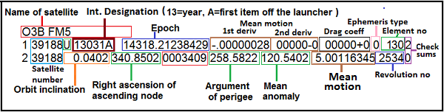
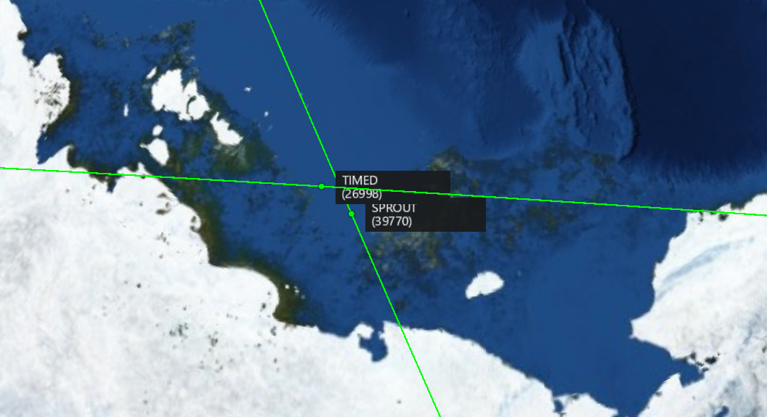
A Few Definitions
Propagate – predict the trajectory of an object in motion. In this case, the objects in question are satellites.
Two-Line Element (TLE) – a set of parameters that define the orbital motion of a satellite. Each Two-Line Element, or TLE represents a single satellite.
Close Approach – when two satellites come into relatively (~10 km) close proximity with each other

Slide 5
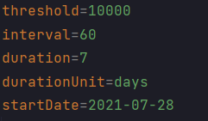
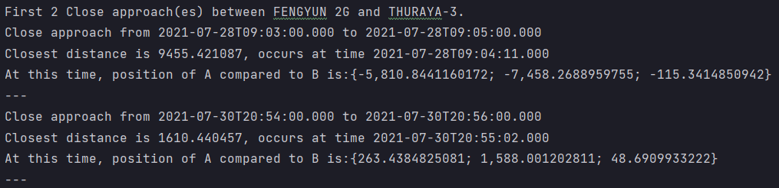
Project Assignment
GOAL: propagate the paths of thousands of satellites over a period, and detect all the close approaches
INPUT: a text file containing satellites represented by TLEs
OUTPUT: a readable log file containing all close approaches between satellite pairs
Advantages:
Parameters such as the starting date, the danger threshold, and duration are all configurable
The program outputs a log file that is both readable for humans, and can be analyzed by computers

Slide 6
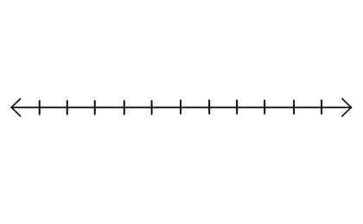
Configurable PARAMETERS
Orbit Trajectory for a Satellite
Duration
Interval
July 28th, 12:01:00 AM
Start:
July 28th, 12:00:00 AM
Each dot represents the state of a satellite at a particular time

Slide 7
The data Flow
Raw Input:
List of TLEs in text file
Read in and parse text
List of Satellites
Propagate satellite paths
List of satellite trajectories, represented by a series of time-stamped coordinates
Find all pairs of satellites that come close to each other
Output:
A log file of all close satellite approaches of satellites in selected data set, ready for further analysis and action
Write out each close approach
Satellite pairs, and the close approaches of each pair
List of pairs of satellites that come into close approach
Find close approach(es) for each pair, and record data for each approach
Notes:
Elaborate on each arrow, talk about the classes and structures that go into each of these, go into some detail here

Slide 8

OREKIT (Orbits Extrapolation Kit)
Set of pre-built functions and data structures that were built to work with satellites and orbits
Abstracted away a lot of complexity, making it easier to focus on higher level data processing
Notes:
Emphasize that this was an integral part of the project,

Slide 9

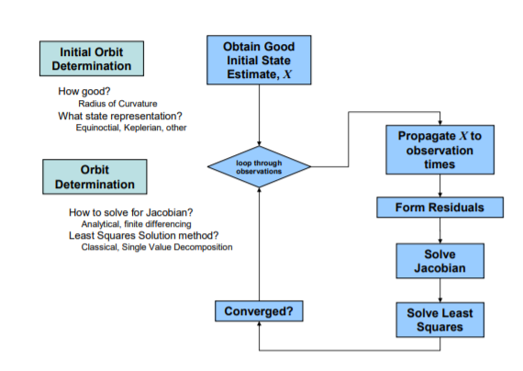
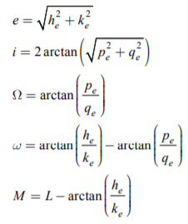
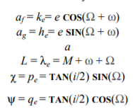
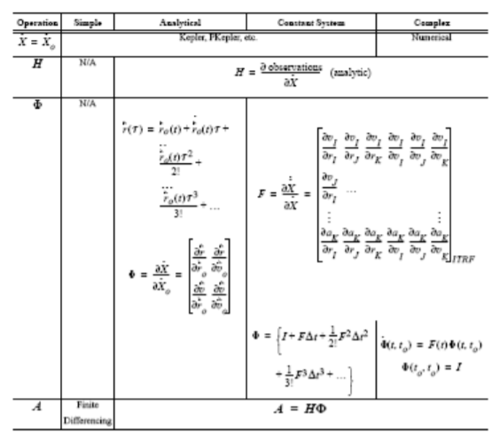
How OREKIT COMES into play: Propagation WITH orekit
List of satellite pathways, represented by a series of time-stamped coordinates
Our satellites in TLE format
Takes care of all the complex calculations
Provides useful data structures that make storing the output of the propagation easier
We have do this thousands of times for every satellite in our list!
Notes:
The point of these two slides is to show that OREKIT helped get rid of complexity in our program. Because orekit takes care of the difficult calculations and provides specialized data structures, we were able to focus on inputting and outputting the data from text.
Also OREKIT is professionally written software, meaning it is more efficient than anything we could have written in 6 weeks

Slide 10
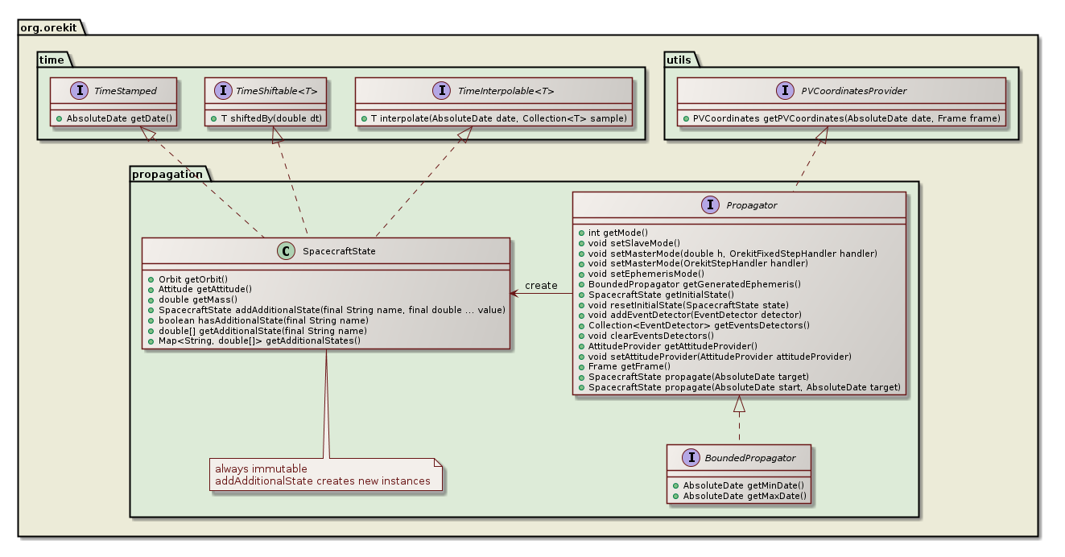
How OREKIT COMES into play: BEHIND the Scenes
List of satellite pathways, represented by a series of time-stamped coordinates
Our satellites in TLE format
Diagram courtesy of OREKIT

Slide 11
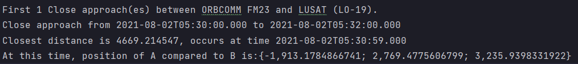
SAMPLE Log Entry
Names of satellites
Timestamps of rough interval
Distance between satellites (meters)
Timestamp of where closest distance occurs
Relative satellite position on 3D inertial plane
Notes:
Talk about how this is both readable by humans, and analyzable by computers

Slide 12
Sample Project Output
Distance Between Two Satellites Graphed over Time
(log 10)
Spreadsheet Data
(1 Second Interval)
Date and Time | Distance in Meters | X Difference | Y Difference | Z Difference
5:30:00 AM | 575244.4175 | 325863.2945 | 424022.2795 | 211953.6733
5:30:01 AM | 565542.9921 | 320314.8446 | 416891.1818 | 208420.2937
5:30:02 AM | 555840.9597 | 314766.0353 | 409759.6338 | 204886.6955
5:30:03 AM | 546138.3313 | 309216.8726 | 402627.6434 | 201352.8827
5:30:04 AM | 536435.1179 | 303667.3626 | 395495.2181 | 197818.8592
5:30:05 AM | 526731.3308 | 298117.5113 | 388362.366 | 194284.6287
5:30:06 AM | 517026.981 | 292567.3248 | 381229.0946 | 190750.1952
… | … | … | … | ...
5:30:59 AM | 4669.214547 | -1913.178487 | 2769.477561 | 3235.939833
Timestamp and distance of closest approach
Notes:
Talk about precision of the data, and how the outputted csv could be useful for analysis in excel

Slide 13
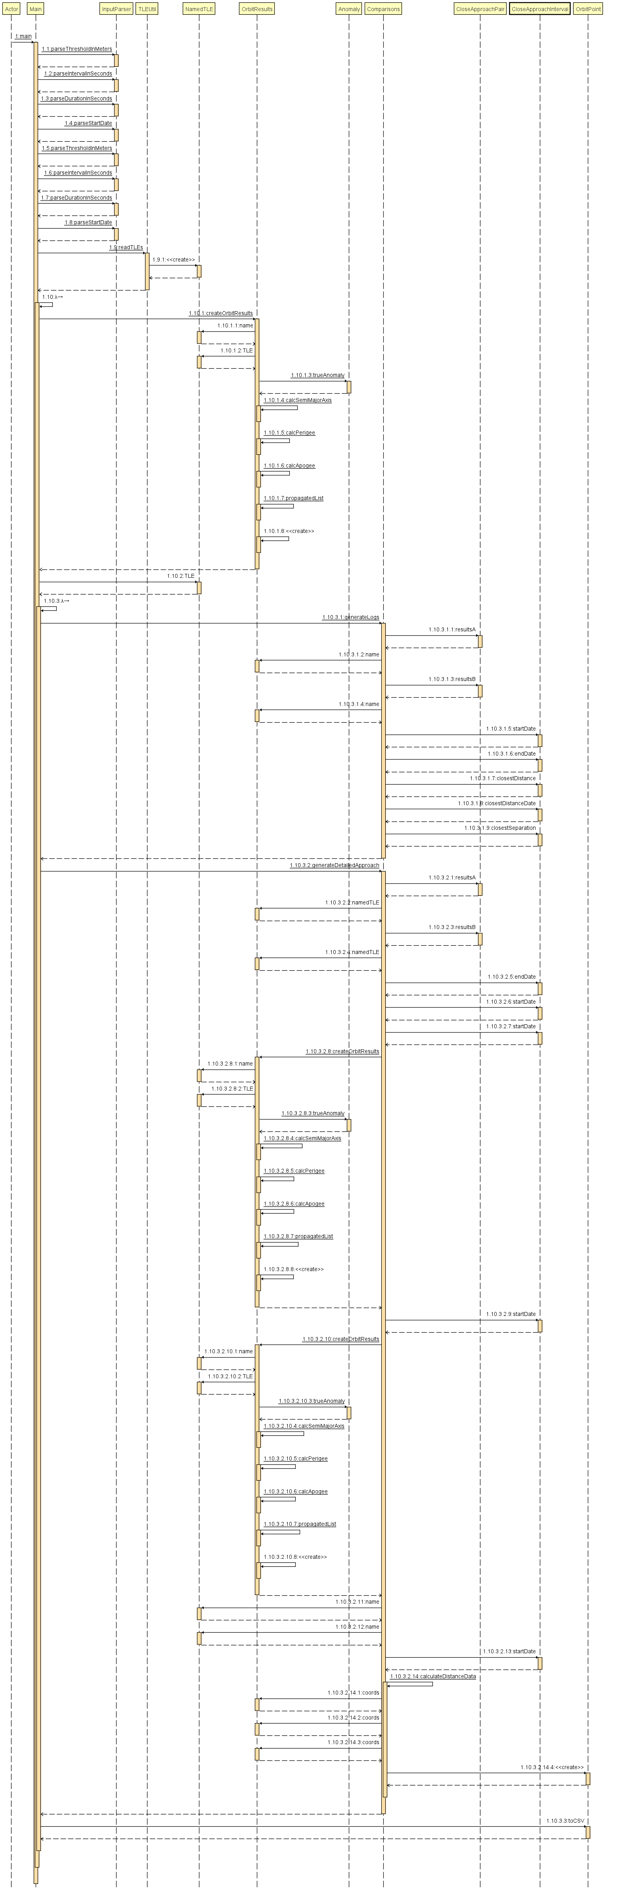

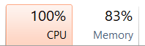
Challenges
Complex structures and dependencies
Learning how to use a build tool
Performance and memory issues
Project run structure
Notes:
Tie in the complex run structure with explanation of how a lot of tailored data structures were needed on top of the OREKIT ones for this project.
Explain what gradle is, talk about the difficulties with libraries, but also what we learned about the advantages it provides
Talk about how this project could be expanded to the entire celestrak catalog, which has about 40k satellites, but due to hardware limitations we could only get around 1000.

Slide 14
Thank you!
Questions?

